Slide 1
Install Visual Studio 2017
Step by step installation guide
Dragos Rosca
Automatica si Calculatoare 2018

Slide 2
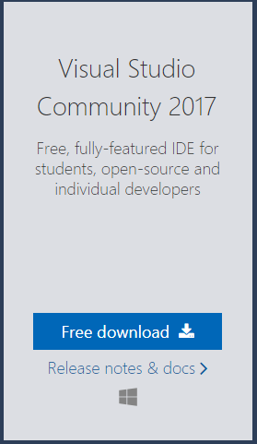
Download
Go to https://www.visualstudio.com/downloads/
Click “Free download”

Slide 3
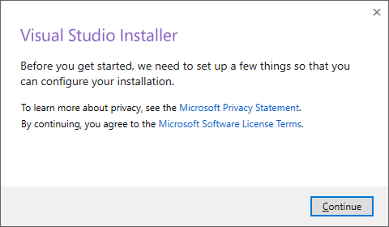
Run Installer
Double click “vs_community__1225120881.1524140890.exe” and give it administrator rights if required
Click “Continue”

Slide 4
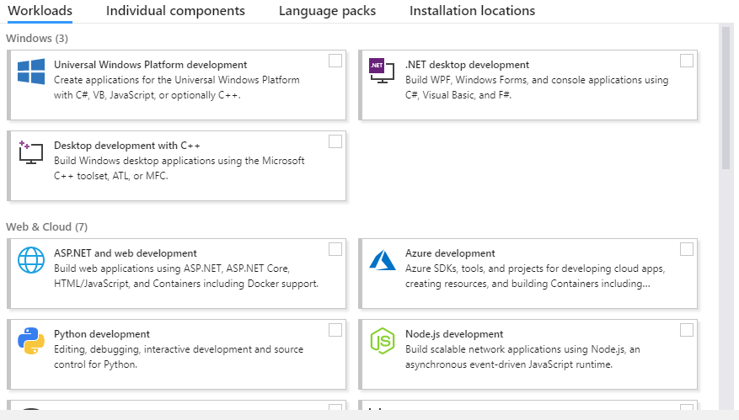
Run Installer
In this list we will select the following:

Slide 5
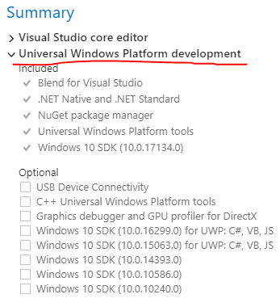

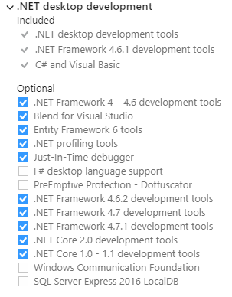

Run Installer
From Window group
Universal Windows Platform Development
.NET desktop development

Slide 6
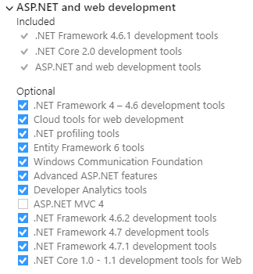

Run Installer
From Web and Cloud group
ASP.NET and web development

Slide 7
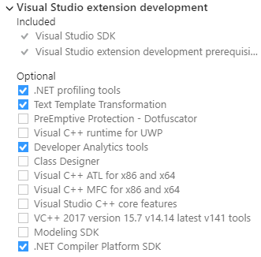


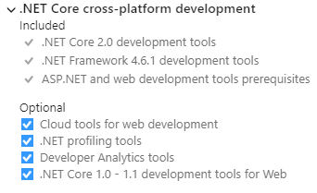
Run Installer
From Mobile & Gaming
Nothing
From Other Toolsets
Visual Studio extension development
.NET Core cross-platform development

Slide 8
Run Installer
If you want to change location click “Change…”
Click “Install”

Slide 9
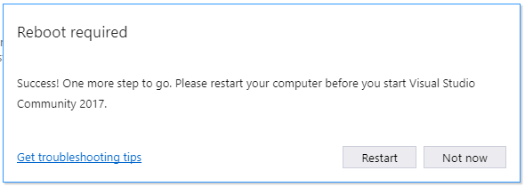
Run Installer
Click Restart

Slide 10
Visual Studio Is Installed
Congratulation!
Automatica si Calculatoare 2018

